Slide 1

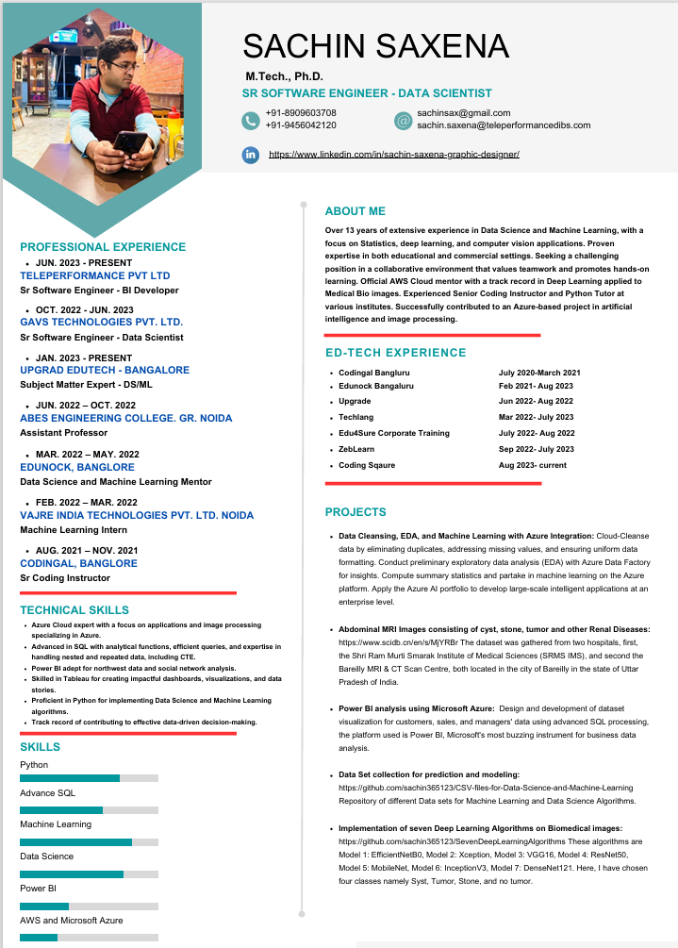



Slide 2
In this video/Lecture, I will provide crucial tips and strategies to help your resume stand out and pass ATS filters. Whether you're new to the
job market or a seasoned professional, these insights will increase your chances of securing more interviews and catching the attention of top employers.
If you want to improve your resume and optimize it for ATS, this video is essential viewing! 🎯

Slide 3

How to Make an
ATS Friendly
Resume!!
(For Freshers/Experienced)

Slide 4


Slide 6
What to write in the CV 4-5 relevant sections
-Resume Summary (More on this later)
-Work-Ex
-Education
-Internships
-Achievements
-Projects
-Extra-Curriculars
-Anything else that makes u stand out

Slide 7

What to write in the CV 4-5 relevant sections
-Resume Summary (More on this later)
-Work-Ex
-Education
-Internships
-Achievements
-Projects
-Extra-Curriculars
-Anything else that makes u stand out

Slide 8

What to write in the CV 4-5 relevant sections
-Resume Summary (More on this later)
-Work-Ex
-Education
-Internships
-Achievements
-Projects
-Extra-Curriculars
-Anything else that makes u stand out

Slide 9
What to write in the CV 4-5 relevant sections
-Resume Summary (More on this later)
-Work-Ex
-Education
-Internships
-Achievements
-Projects
-Extra-Curriculars
-Anything else that makes u stand out

Slide 10
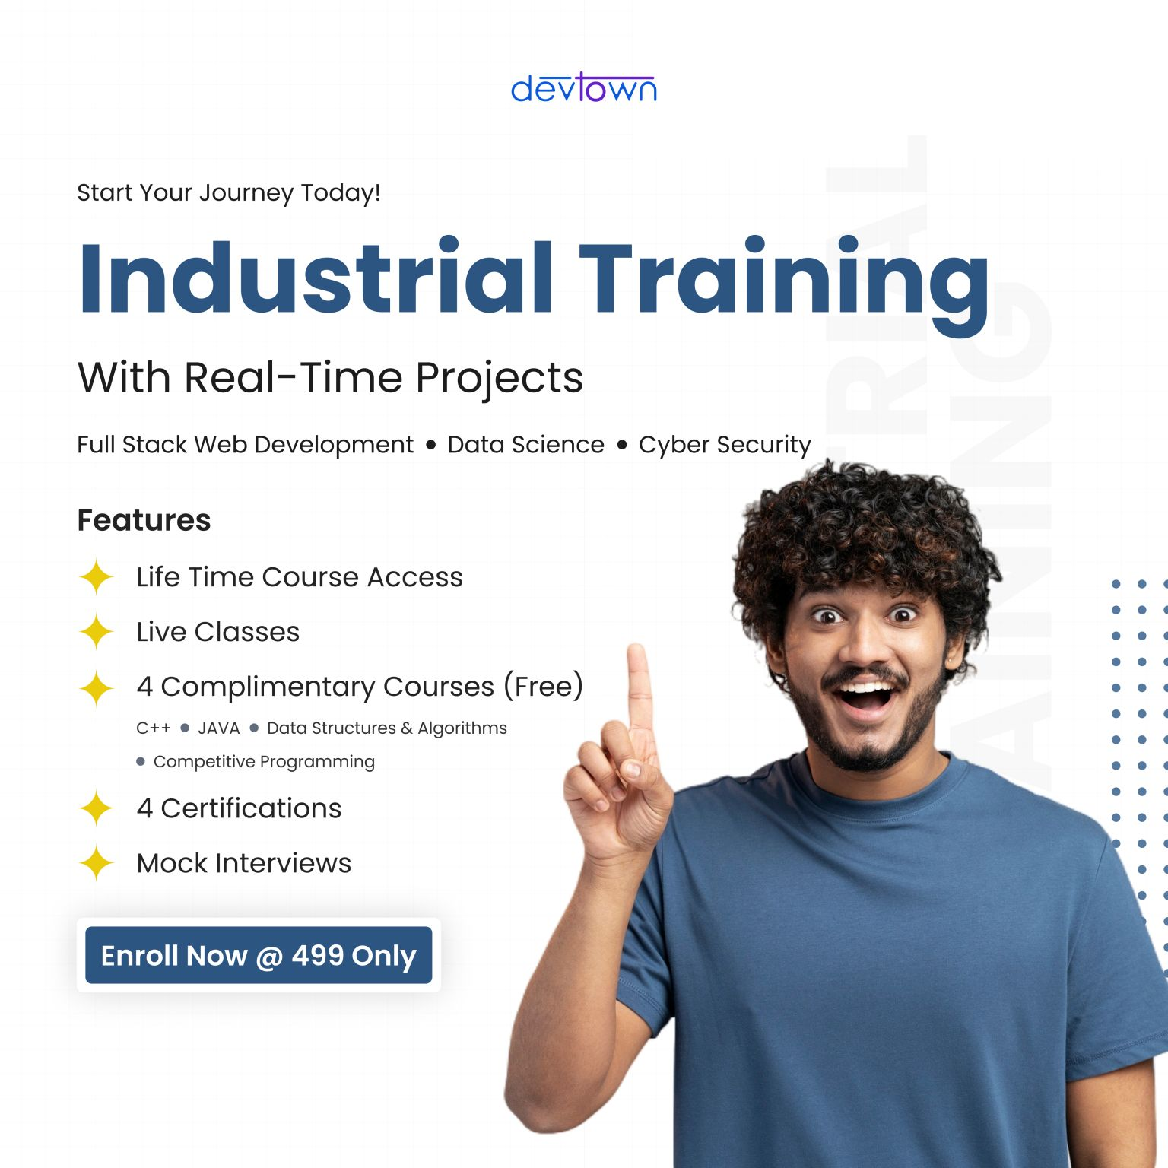
How to write about your work experience:
- Use Action words like
Directed/Managed/Spearheaded instead of Duties included

Slide 11
How to write about your work experience:
- Use Action words like
Directed/Managed/Spearheaded instead of Duties included

Slide 12
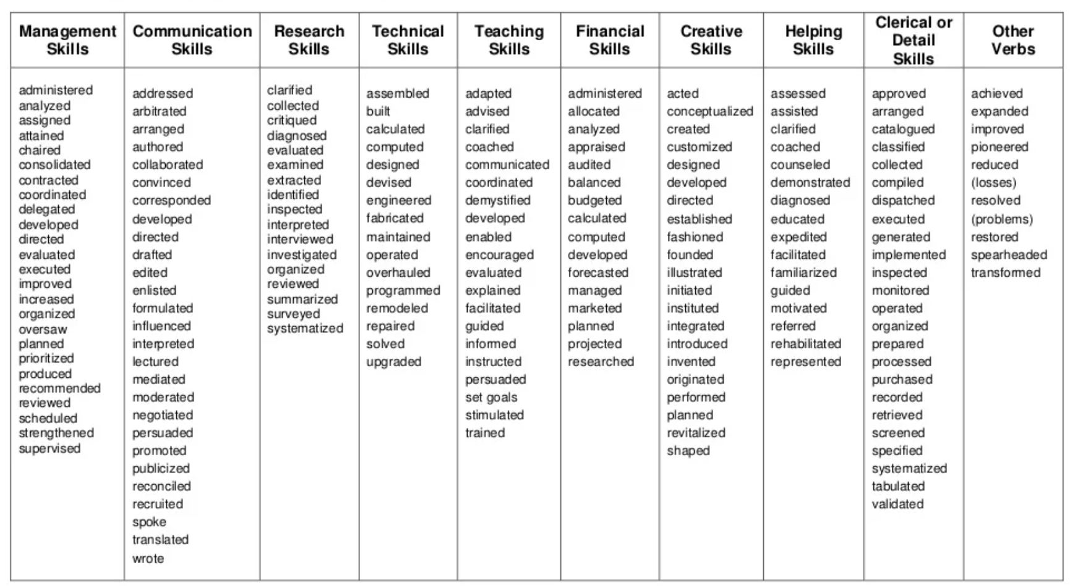
Some useful words

Slide 13
Some useful words

Slide 14
Some useful words

Slide 15
Some useful words

Slide 16
Very IMPORTANT to get shortlisted:
- More than 90% companies now use software (called ATS) to shortlist
- Software checks keywords to match job description (JD)
- Hence, you need TO include relevant keywords in your CV and tailor each CV based on the specific job

Slide 17
Very IMPORTANT to get shortlisted:
- More than 90% companies now use software (called ATS) to shortlist
- Software checks keywords to match job description (JD)
- Hence, you need TO include relevant keywords in your CV and tailor each CV based on the specific job

Slide 18
Very IMPORTANT to get shortlisted:
- More than 90% companies now use software (called ATS) to shortlist
- Software checks keywords to match job description (JD)
- Hence, you need to include relevant keywords in your CV and tailor each CV based on the specific job

Slide 19
Resume Summary:
- Not required for fresher
- Not more than 3 sentences.
- Mention experience, top achievements
- What type of role you are looking at

Slide 20

Resume Summary:
- Not required for fresher
- Not more than 3 sentences.
- Mention experience, top achievements
- What type of role you are looking at

Slide 21

Resume Summary:
- Not required for fresher
- Not more than 3 sentences.
- Mention experience, top achievements
- What type of role you are looking at

Slide 22
Resume Summary:
- Not required for fresher
- Not more than 3 sentences.
- Mention experience, top achievements
- What type of role you are looking at

Slide 23
How to check my Resume ATS score?
AI-powered resume analysis engine: https://resumeworded.com/results-v2
https://www.jobscan.co/

Slide 24
Dos:
- Send file as firstname_lastname, not as cv/resume
- Send pdf file and not as a word file
- Include action words from Job Description
- Choose a neat template
- Fit most points in 1 line
- Length: 1 page for work-ex < 10 yrs, 2 pages max

Slide 25
Dos:
- Send file as firstname_lastname, not as cv/resume
- Send pdf file and not as a word file
- Include action words from Job Description
- Choose a neat template
- Fit most points in 1 line
- Length: 1 page for work-ex < 10 yrs, 2 pages max

Slide 26
Dos:
- Send file as firstname_lastname, not as cv/resume
- Send pdf file and not as a word file
- Include action words from Job Description
- Choose a neat template
- Fit most points in 1 line
- Length: 1 page for work-ex < 10 yrs, 2 pages max

Slide 27
Donts:
-Don’t make bold claims that cannot be backed up
-Don’t just list job duties; focus on accomplishments
-Avoid personal pronouns (I/me/my)
-Unprofessional email ID like coolguy352
-No need for Photo/DOB
-Don't bold too many words

Slide 28
Donts:
-Don’t make bold claims that cannot be backed up
-Don’t just list job duties; focus on accomplishments
-Avoid personal pronouns (I/me/my)
-Unprofessional email ID like coolguy352
-No need for Photo/DOB
-Don't bold too many words

Slide 29

Donts:
-Don’t make bold claims that cannot be backed up
-Don’t just list job duties; focus on accomplishments
-Avoid personal pronouns (I/me/my)
-Unprofessional email ID like coolguy352
-No need for Photo/DOB
-Don't bold too many words

Slide 30
Donts:
-Don’t make bold claims that cannot be backed up
-Don’t just list job duties; focus on accomplishments
-Avoid personal pronouns (I/me/my)
-Unprofessional email ID like coolguy352
-No need for Photo/DOB
-Don't bold too many words

Slide 31
Donts:
-Don’t make bold claims that cannot be backed up
-Don’t just list job duties; focus on accomplishments
-Avoid personal pronouns (I/me/my)
-Unprofessional email ID like coolguy352
-No need for Photo/DOB
-Don't bold too many words

Slide 32
Common Mistakes:
-Typos/ grammatical errors
-More than 2 lines on any point
- Inconsistent font size/line spacing
- Being unethical like disclosing confidential info
- Verbose resume with length > 2 pages

Slide 33
Technical aspects
-Select a professional font eg Arial/ Calibri/Garamond
- Readable size (10.5-12) for text
- Leave ample white-space so that it is soothing to read
- 1/2-1 inch margins on all sides
- Single spacing works best

Slide 34
For example following is the Job summary for ML Engineer and Data Scientist:
Strong understanding of Azure environment (PaaS, IaaS) and experience in working with hybrid model.
Ability to guide and instruct mid-size team of Azure Data Engineers.
Understand and design/reverse engineering AWS DataSync ETL codes, implement the same data solutions through Azure services.
Design and build simple to complex ETLs in Azure Data Factory, Synapse Spark Notebooks and Azure DataBricks.
Should be able to design modules that has security and authorization frameworks.
Analyze current business practices, processes and procedures and identify future opportunities for leveraging Azure data & analytics PaaS services.
Minimum 5-10 years of ETL experience using Azure data services

Slide 35
For example following is the Job summary for ML Engineer and Data Scientist:
Strong understanding of Azure environment (PaaS, IaaS) and experience in working with hybrid model.
Ability to guide and instruct mid-size team of Azure Data Engineers.
Understand and design/reverse engineering AWS DataSync ETL codes, implement the same data solutions through Azure services.
Design and build simple to complex ETLs in Azure Data Factory, Synapse Spark Notebooks and Azure DataBricks.
Should be able to design modules that has security and authorization frameworks.
Analyze current business practices, processes and procedures and identify future opportunities for leveraging Azure data & analytics PaaS services.
Minimum 5-10 years of ETL experience using Azure data services

Slide 36
